Slide 1
Oliver Twist

Slide 2
Charles Dickens
He was an English novelist, generally considered the greatest of the Victorian period. Dickens's works are characterized by attacks on social evils, injustice, and hypocrisy. He had also experienced in his youth oppression, when he was forced to end school in early teens and work in a factory. Dickens's good, bad, and comic characters, such as the cruel miser Scrooge, the aspiring novelist David Copperfield, or the trusting and innocent Mr. Pickwick, have fascinated generations of readers.
Oliver Twist is about a boy born in the workhouse for the poor. Some of the boys make him ask for more food. As the result, Oliver is then sold. Suffering terrible cruelty, he runs away and joins a young criminal who teaches him how to steal wallets. The general theme of the novel is that of selfishness and dishonesty as most people take advantage of Oliver. Few people show him love and kindness.

Slide 3
Vocabulary
Workhouse was a place where those unable to support themselves were offered accommodation and employment.
The board – a committee.
The beadle - a minor official who carries out various civil, educational, or ceremonial duties.
An orphan - a person, especially a minor, both or (rarely) one of whose parents have died.
An apprentice - learner, starter, beginner, greenhorn: John served as an apprentice in the soap factory.
A coffin - casket, pall, (pine) box; sarcophagus: The coffin was slowly lowered into the grave.

Slide 4
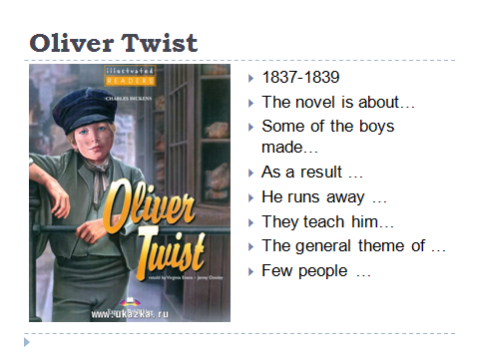
Thanks for your work

